Slide 1
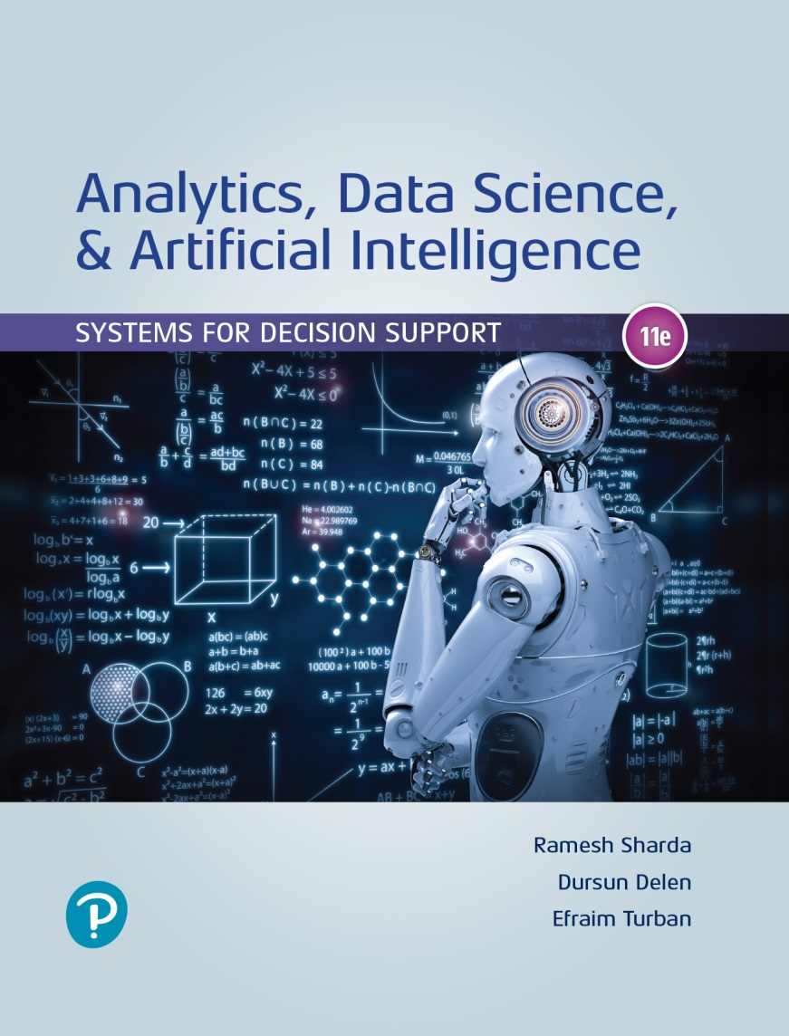
Analytics, Data Science and A I: Systems for Decision Support
Eleventh Edition
Chapter 1
Overview of Business Intelligence, Analytics, Data Science, and Artificial Intelligence: Systems for Decision Support
Slide in this Presentation Contain Hyperlinks. JAWS users should be able to get a list of links by using INSERT+F7
Copyright © 2020, 2015, 2011 Pearson Education, Inc. All Rights Reserved
Notes:
If this PowerPoint presentation contains mathematical equations, you may need to check that your computer has the following installed:
1) Math Type Plugin
2) Math Player (free versions available)
3) NVDA Reader (free versions available)

Slide 2
Learning Objectives (1 of 2)
1.1 Understand the need for computerized support of managerial decision making.
1.2 Understand the development of systems for providing decision-making support.
1.3 Recognize the evolution of such computerized support to the current state of analytics/data science and artificial intelligence.
1.4 Describe the business intelligence (B I) methodology and concepts.
1.5 Understand the different types of analytics and review selected applications.
Notes:
Slide 2 is list of textbook LO numbers and statements

Slide 3
Learning Objectives (2 of 2)
1.6 Understand the basic concepts of artificial intelligence (A I) and see selected applications.
1.7 Understand the analytics ecosystem to identify various key players and career opportunities.
Notes:
Slide 2 is a list of textbook LO numbers and statements

Slide 4
Changing Business Environments And Evolving Needs For Decision Support And Analytics
Big-bet, high-risk decisions.
Cross-cutting decisions, which are repetitive but high risk that require group work.
Ad hoc decisions that arise episodically.
Delegated decisions to individuals or small groups.

Slide 5
Decision Making Process
What actions or steps do you take when trying to make a decision?

Slide 6
Decision Making Process
The four step managerial process:
Define the problem
Construct a model
Identify and evaluate possible solutions
Compare, choose, and recommend a solution to the problem

Slide 7
Decision Making Process
A more detailed process is offered by Quain (2018):
Understand the decision you have to make.
Collect all the information.
Identify the alternatives.
Evaluate the pros and cons.
Select the best alternative.
Make the decision.
Evaluate the impact of your decision.

Slide 8
Decision Making Process
What are some of the factors that might impact your decision making process?

Slide 9
The Influence of the External and Internal Environments on the Process
Technology, I S, Internet, globalization, …
Government regulations, compliance, …
Political factors
Economic factors
Social and psychological factors
Environment factors
Need to make rapid decision, changing market conditions, …

Slide 10
Decision-making Processes And Computerized Decision Support Framework
What is “Decision making”?
Is a process of choosing among two or more alternative courses of action for the purpose of attaining one or more goals
Simon’s Decision Making Process
Proposed in 1977 by Herbert Alexander Simon (an American economist and political scientist)
Includes three phases:
Intelligence
Design
Choice
[+] Implementation
[+] Monitoring

Slide 11
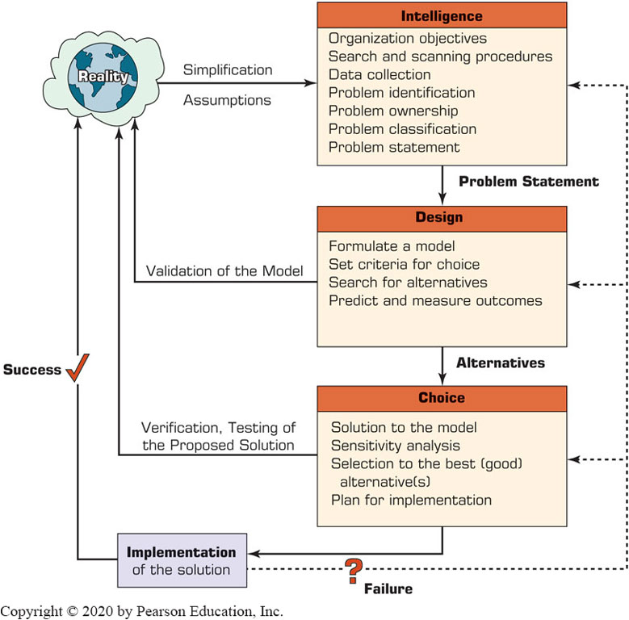
The Decision-Making Process

Slide 12
The Classical Decision Support System Framework
Degree of structuredness
Structured, unstructured, semi-structured problems
Type of control
Operational, managerial, strategic
The decision Support matrix
Computer support for …
Structured decisions
Unstructured decisions
Semi-structured problems

Slide 13
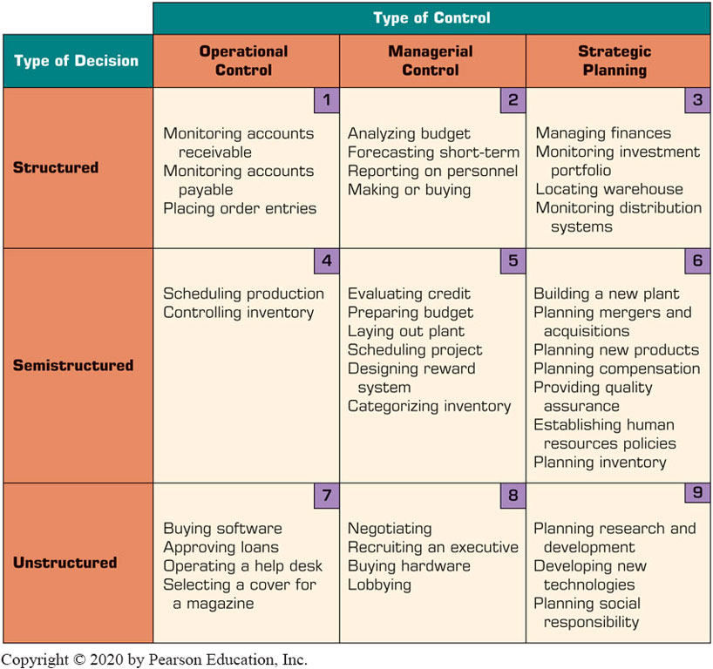
Decision Support Framework

Slide 14
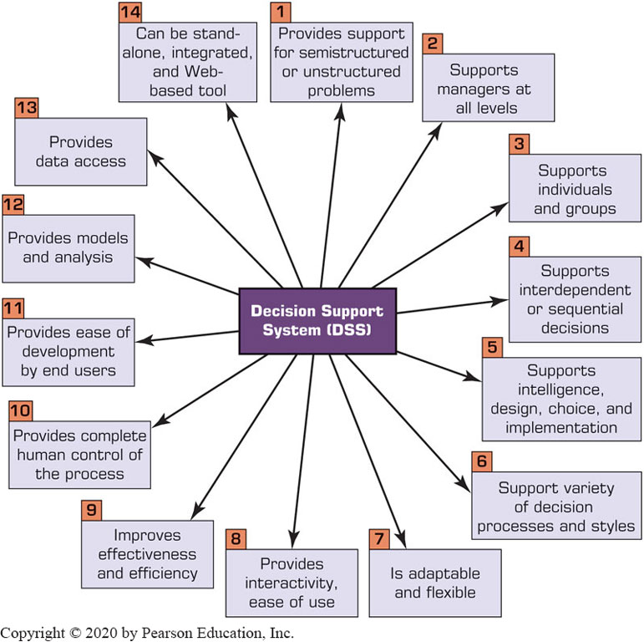
Key Characteristics and Capabilities of Decision Support System (D S S)

Slide 15
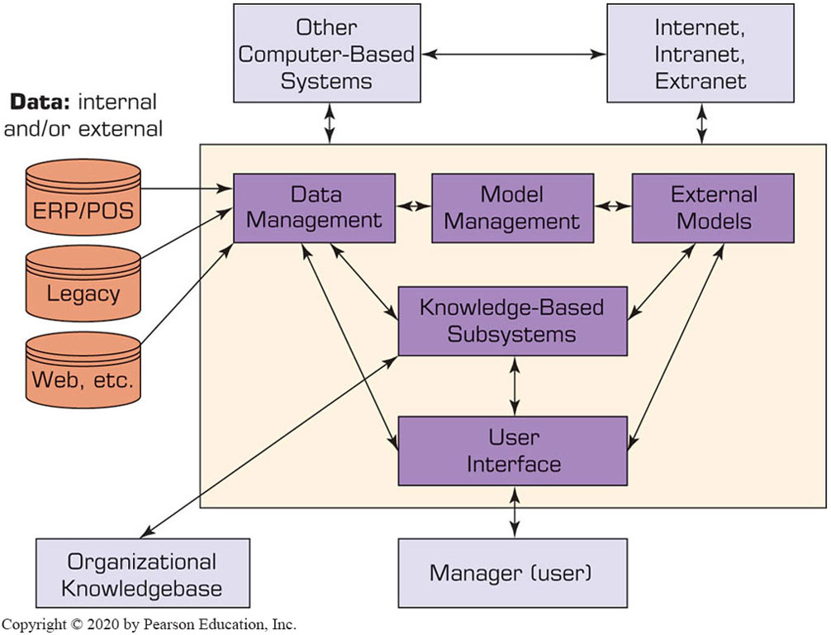
Components of a D S S (1 of 2)
The Data Management System
D S S database
Database management system (D B M S)
Data directory
Query facility

Slide 16
Components of a D S S (2 of 2)
The Model Management Subsystem
Model base
M B M S
Modelling language
Model directory
Model execution, integration, and command processor
The User Interface Subsystem
The Knowledge-Based Subsystem

Slide 17
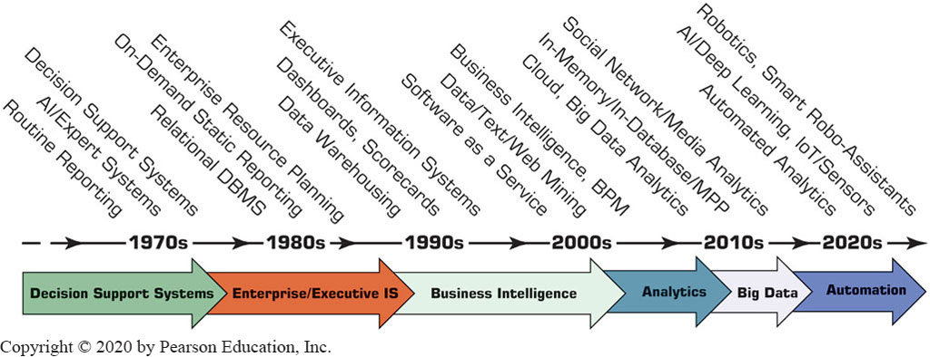
Evolution of Computerized Decision Support to Business Intelligence, Analytics, Data Science
Figure 1.5 Evolution of Decision Support, Business Intelligence, Analytics, and A I.

Slide 18
A Framework for Business Intelligence
Definitions of business intelligence (B I)
A brief history of B I
The architecture of B I
Data warehousing (D W) [as a foundation of B I]
Business performance management (B P M)
User interface (dashboard)
Transaction processing versus analytics processing
Appropriate planning and alignment of B I with the business strategy

Slide 19
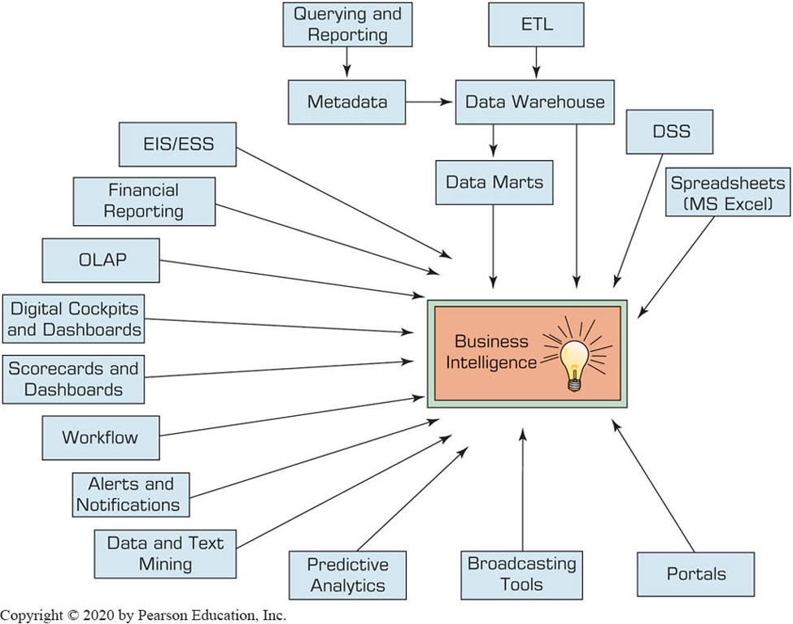
Evolution of Business Intelligence (B I)

Slide 20
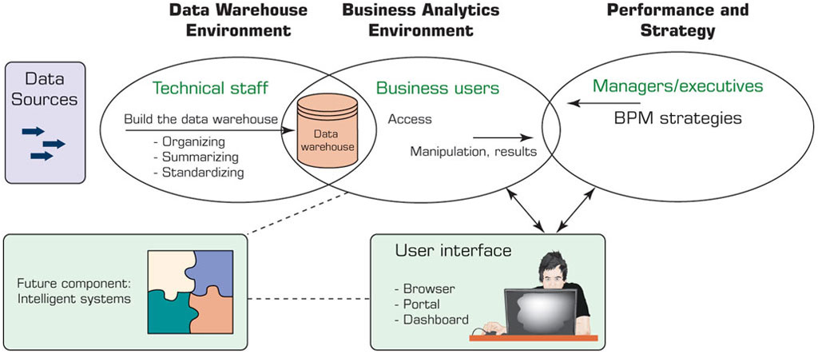
The Origins and Drivers of B I
Figure 1.7 A High-Level Architecture of B I.
Source: Based on W. Eckerson. (2003). Smart Companies in the 21st Century: The Secrets of Creating Successful Business Intelligent Solutions Seattle, W A: The Data Warehousing Institute, p. 32, Illustration 5.

Slide 21
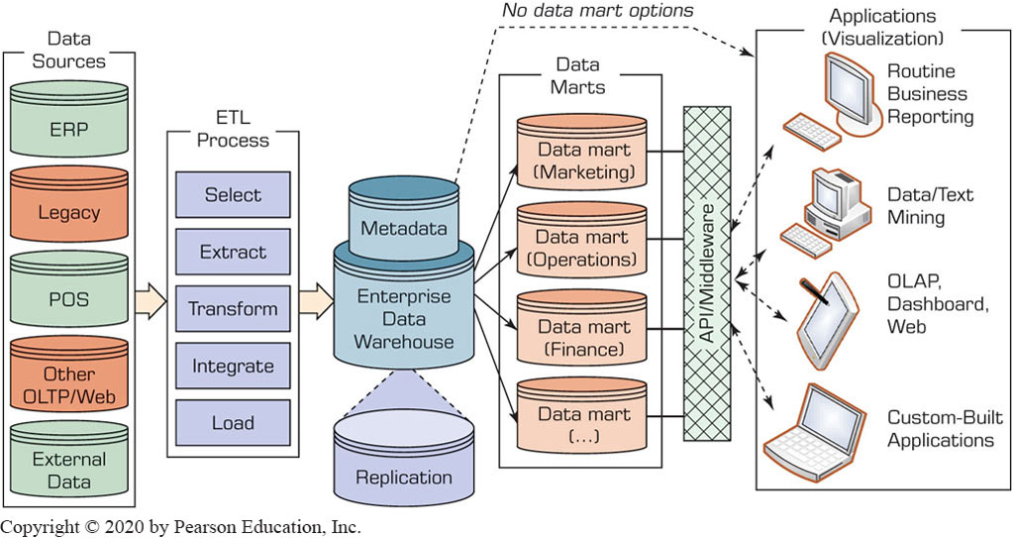
Data Warehouse Framework

Slide 22
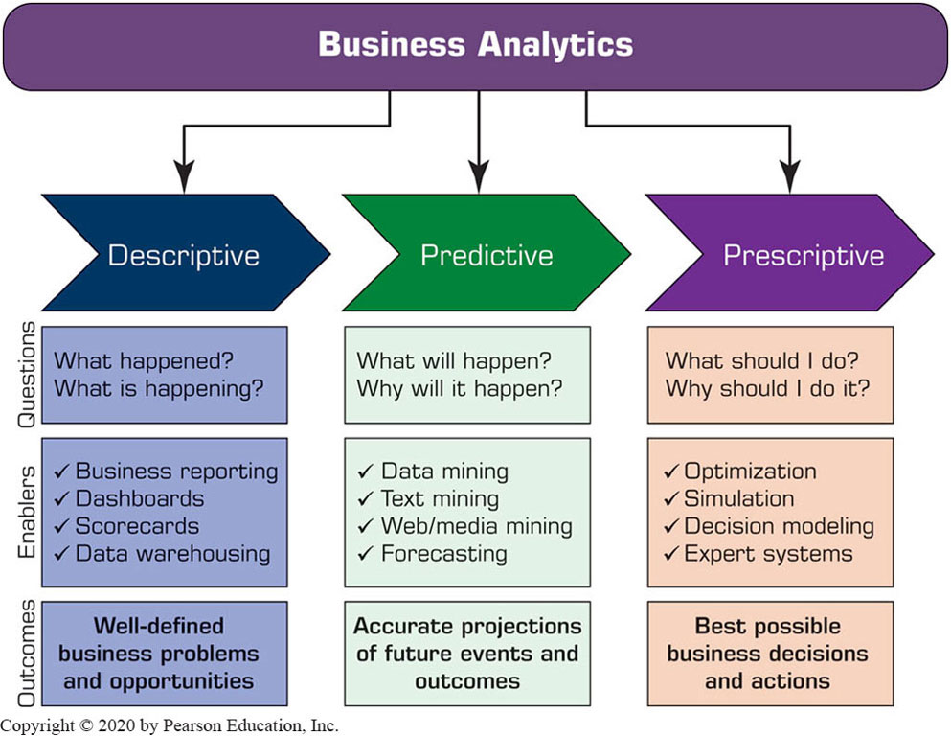
Analytics Overview (1 of 2)

Slide 23
Analytics Overview (2 of 2)
Three types of analytics
Descriptive (or reporting) analytics …
Predictive analytics …
Prescriptive analytics …
Analytics applied to different domains
Analytics or data science?
What is Big Data?
Structured and unstructured data from all types of different sources including IoT, sensors, log files, social media, streaming media, etc.
Important related developments:
Hadoop Distributed File System (HDFS)
MapReduce programming paradigm

Slide 24
Artificial Intelligence Overview
What Is artificial intelligence (A I)?

Slide 25
Artificial Intelligence Overview
What Is artificial intelligence (A I)?
AI studies the human thought processes while trying to duplicate those processes in machines.
Technology that can learn to do things better over time.
Technology that can understand human language.
Technology that can answer questions.

Slide 26
Artificial Intelligence Overview
Major Goals of AI are to:
Create intelligent machines that can do tasks currently done by humans
Learn to do things better over time.
Understand human language.
Answer questions.

Slide 27
The Landscape of A I
Major technologies
Machine learning, deep learning, intelligent agents.
Knowledge-based technologies
Expert systems, recommendation engines, chatbots, virtual personal assistants, robo advisors.
Biometric related technologies
Natural language processing, image recognition, voice recognition, biometric recognition.

Slide 28
The Landscape of A I
Support theories, tools, and platforms
Theories: CS, cognitive science, linguistics, mathematics, psychology, statistics, etc.
Tools: Sensors, augmented reality, logic, context awareness, data mining, etc.
Platforms: IBM, Microsoft, Nvidia, etc.
A I applications
Smart cities, smart homes, autonomous vehicles, automatic decisions, language translation, robotics, fraud detection, content screening, prediction, personalized services, etc.

Slide 29
Narrow (weak) versus general (strong) A I
Weak AI focuses on one narrow field (domain).
Examples: expert systems in general (specific domain area), SIRI and Alexa (knowledge-based), automated call centers, computer vision, chess, medical diagnosis, equipment failure diagnosis, etc.
Strong AI exhibit real intelligence, machines perform the full range of human cognitive capabilities.
Basically, ability to replicate humans.
Some applications exist, however, in very narrow domains like autonomous vehicles.

Slide 30
The three flavors of A I decisions
Assisted intelligence (weak AI)
Work only in narrow domains.
Requires clearly defined inputs and outputs.
Examples: monitoring systems (like car alerts), virtual assistants (Alexa, Siri), healthcare diagnosis.

Slide 31
The three flavors of A I decisions
Autonomous AI
Systems that are in the realm of strong AI but in very narrow domains.
Machines will act as experts and have absolute decision making power.
Examples: Autonomous vehicles, robo-advisors (complete automated investment services based on answered questions).
https://www.investopedia.com/terms/r/roboadvisor-roboadviser.asp

Slide 32
The three flavors of A I decisions
Augmented Intelligence (Intelligence Augmentation)
Between assisted and autonomous AI
Technology focuses on augmenting computer abilities to extend human cognitive abilities.
Excel in solving complex human or industry problems in specific domains.
Provides insights and recommendations including explanations.
Can offer new solutions by combining existing and discovered information.
Most AI applications fall in this category.
Examples: Cybercrime fighting, e-commerce decisions.

Slide 33
Convergence of Analytics and A I
Based on a Gartner study, 70-80% of analytics initiatives will not meet enterprise objectives.
High percentage as well for AI on its own.
What are the major differences between analytics and AI?

Slide 34
Convergence of Analytics and A I
Analytics is about:
Computation/Analysis of historical data
Big Data
Statistics
Management Science (mathematical modeling)
AI is about:
Imitate the way people think, learn, reason ,make decisions, solve problems
Cognitive Computing
Knowledge
Intelligence

Slide 35
Convergence of Analytics and A I
Issues (problems) with Analytics:
Results of analytics may be good for some applications but not for others
Models are as good as their input data and assumptions (garbage-in, garbage-out)
Incomplete data
Inaccurate data from people
Quickly changing environment factors
Quality of collected data
Issues (problems) with AI:
Some similar issues as in analytics
Need for continuously updated knowledge (i.e., big data)

Slide 36
Convergence of Analytics and A I
The combination of AI and analytics can help produce much better results.
AI can process different situations very fast and produce lots of data that can be analyzed via Business Intelligence/Analytics
Example:
https://www.youtube.com/watch?v=_t-ChKxXACw

Slide 37

Copyright
This work is protected by United States copyright laws and is provided solely for the use of instructors in teaching their courses and assessing student learning. Dissemination or sale of any part of this work (including on the World Wide Web) will destroy the integrity of the work and is not permitted. The work and materials from it should never be made available to students except by instructors using the accompanying text in their classes. All recipients of this work are expected to abide by these restrictions and to honor the intended pedagogical purposes and the needs of other instructors who rely on these materials.

